Slide 1
Design Patterns CHALLENGE
Endava bank, march 2018

Slide 2
agenda
refactor
Design patterns
demo
Q&A

Slide 3
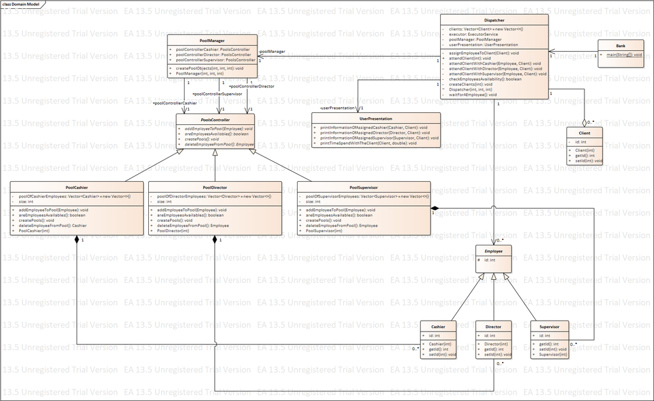
refactor
Before
After
UML_DIAGRAM

Slide 4
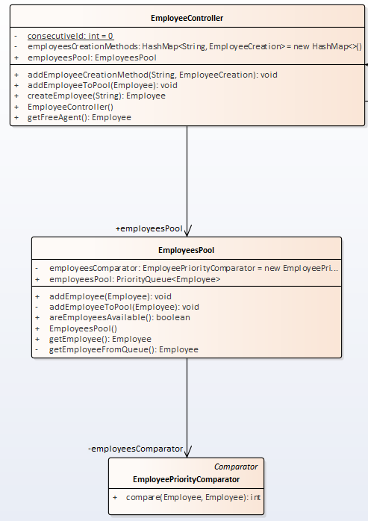
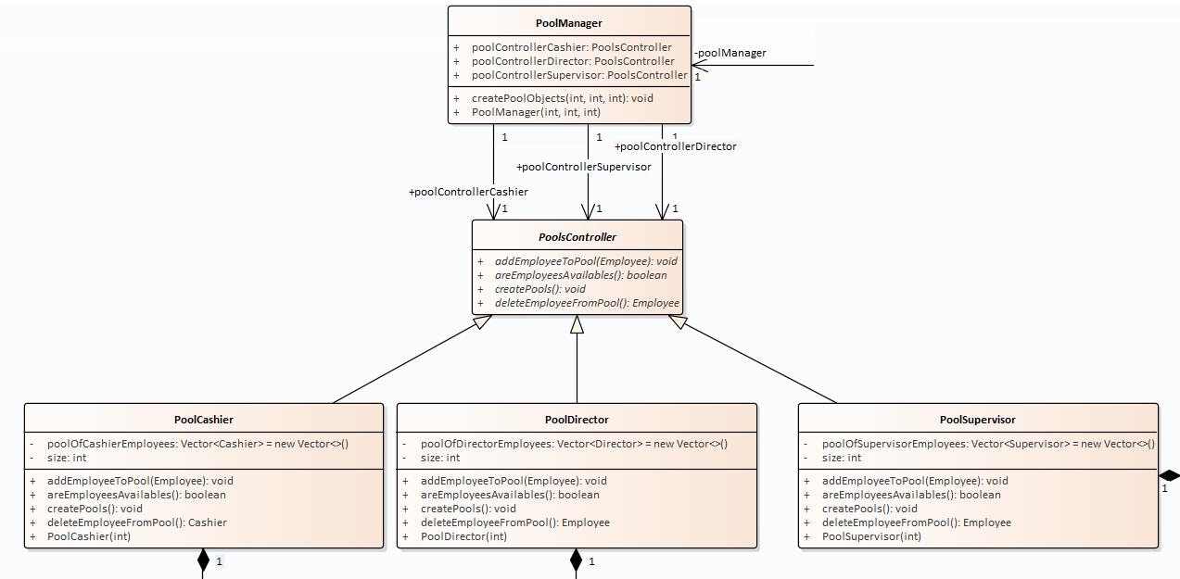
refactor
Before
After

Slide 5
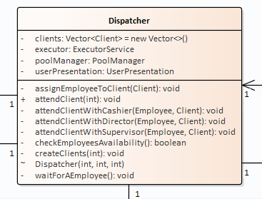
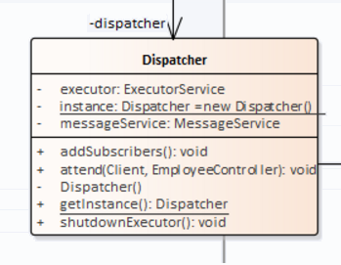
refactor
Before
After

Slide 6
agenda
refactor
Design patterns
demo
Q&A

Slide 7
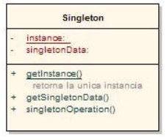
Singleton
structure
implementation
[1]

Slide 8
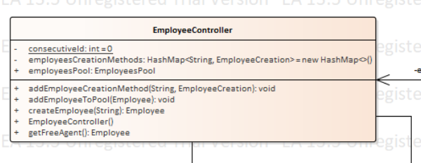
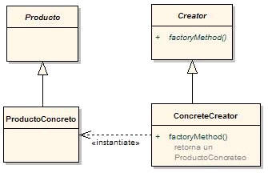
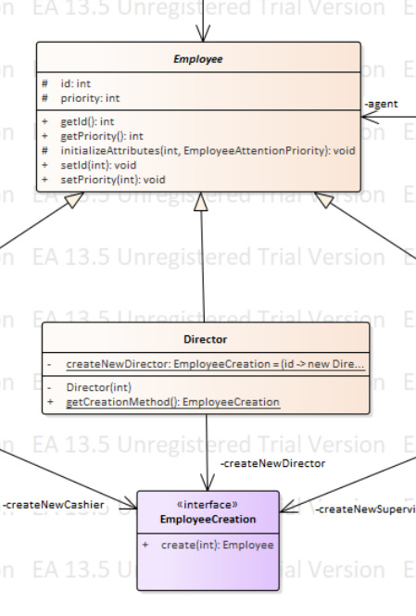
factory
structure
implementation
[2]

Slide 9
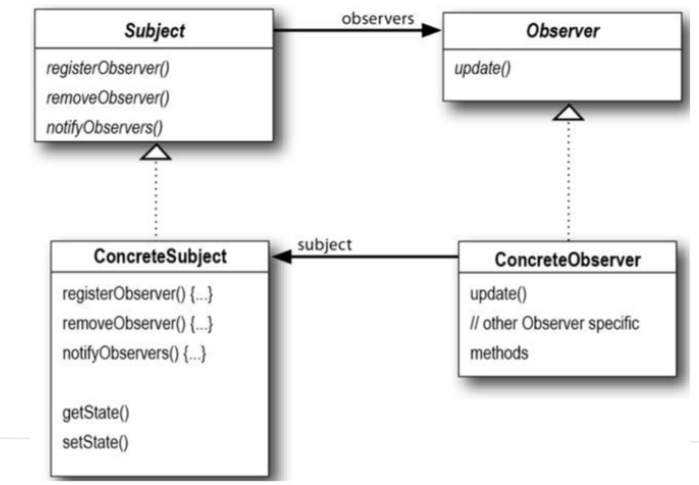
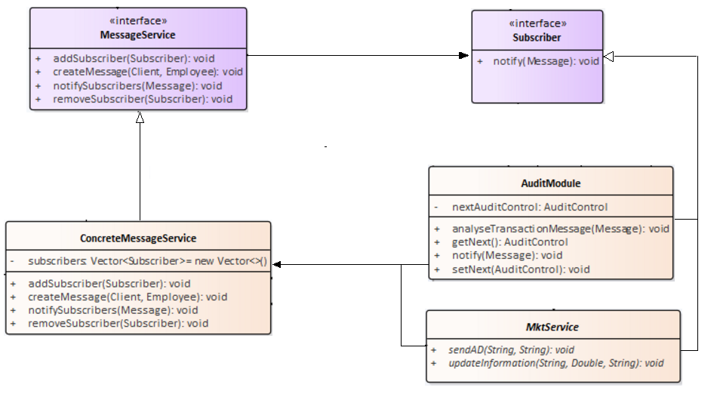
observer
structure
implementation
[3]

Slide 10
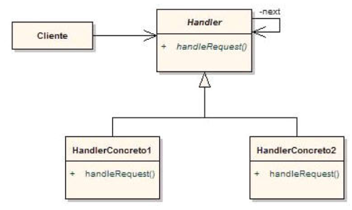
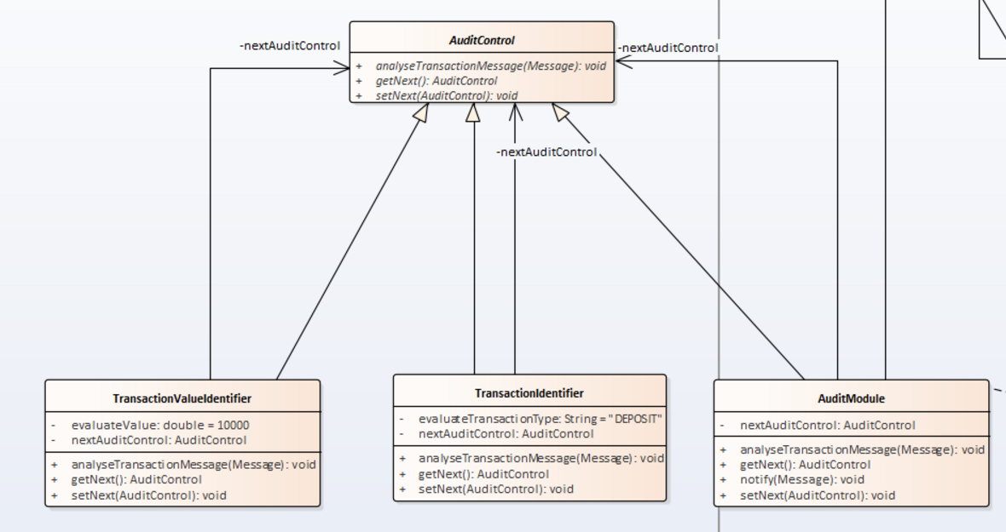
Chain of responsibility
structure
implementation
[4]

Slide 11
agenda
refactor
Design patterns
demo
Q&A

Slide 12
agenda
refactor
Design patterns
demo
Q&A

Slide 13

Q&a

Slide 14
References
[1] Mi granito de java http://migranitodejava.blogspot.com.co/2011/05/singleton.html
[2] Mi granito de java http://migranitodejava.blogspot.com.co/2011/05/factory-method.html
[3] Mi granito de java http://migranitodejava.blogspot.com.co/2011/06/observer.html
[4] Mi granito de java http://migranitodejava.blogspot.com.co/2011/05/chain-of-responsibility.html

Slide 15
Eduardo galeano
Application management
Luis Zarate
Testing
Sebastian puerto
devops

